Slide 1

18CSE357E- BIOMETRICS
Elective
Academic Year 2022-2023 (Odd Semesters)
Dr. C. VIJAYAKUMARAN
Associate Professor/Ctech
Mobile: 9444328196
Email: vijayakc@srmist.edu.in
Room: TP1509/TP106

Slide 2

Session – 5 & 6
Image Processing Basics
What is an Image?
Image Acquition
Type, Point Operations
Geometric Transformations
First and Second order derivatives
Steps in Edge Detection, Smoothing, Enhancement, Thresholding & Localization

Slide 3
Image Processing - Basics
Image
An image may be defined as a two-dimensional function, f(x, y), where x and y are spatial (plane) coordinates, and the amplitude of f at any pair of coordinates (x, y) is called the intensity or gray level of the image at that point.
When x, y, and the amplitude values of f are all finite, discrete quantities, we call the image a digital image.
These elements are referred to as picture elements, image elements, pels, and pixels
An image can be defined by a two-dimensional array specifically arranged in rows and columns.

Slide 4
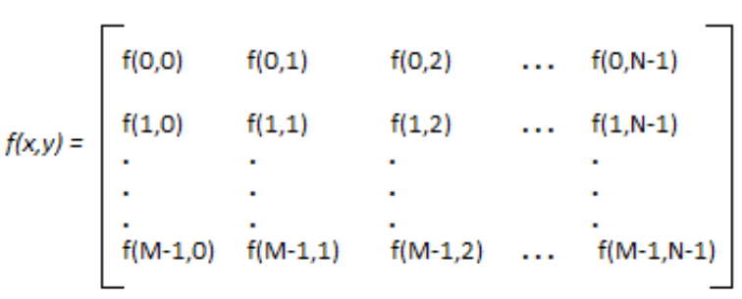
Image Processing - Basics
An Image is represented as a 2D Matrix

Slide 5
Types of Images
Binary Images
It is the simplest type of image. Also called as silhouette image
It takes only two values i.e, Black and White or 0 and 1.
The binary image consists of a 1-bit image and it takes only 1 binary digit to represent a pixel.
Binary images are mostly used for general shape or outline.
For Example: Optical Character Recognition (OCR).

Slide 6
Pros & Cons of Binary Images
Advantages
Easy to acquire: simple digital cameras can be used or low-cost scanners, or thresholding may be applied to grey-level images.
Low storage: no more than 1 bit/pixel
Simple processing: the algorithms are much simpler than those applied to grey-level images.
Disadvantages
Limited application: Application is restricted to tasks where internal detail is not required as a distinguishing characteristic.
Does not extend to 3D:
Specialised lighting is required: it is difficult to obtain reliable binary images without restricting the environment. The simplest example is an overhead projector or light box.

Slide 7
Thresholding
Binary images are generated using threshold operation.
In the simplest case, an image may consist of a single object or several separated objects of relatively high intensity, viewed against a background of relatively low intensity. This allows figure/ground separation by thresholding.
In order to create the two-valued binary image a simple threshold may be applied so that all the pixels in the image plane are classified into object and background pixels.
A binary image function can then be constructed such that pixels above the threshold are foreground (``1'') and below the threshold are background (``0'').

Slide 8
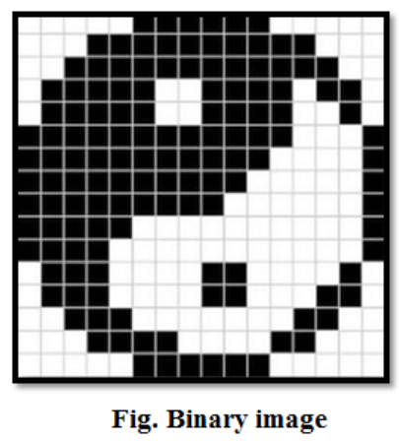
Types of Images

Slide 9
Types of Images
Gray-scale images
Grayscale images are monochrome images, means they have only one color.
Grayscale images do not contain any information about color.
Each pixel determines available different grey levels.
A normal grayscale image contains 8 bits/pixel data, which has 256 different grey levels.
In medical images and astronomy, 12 or 16 bits/pixel images are used.

Slide 10
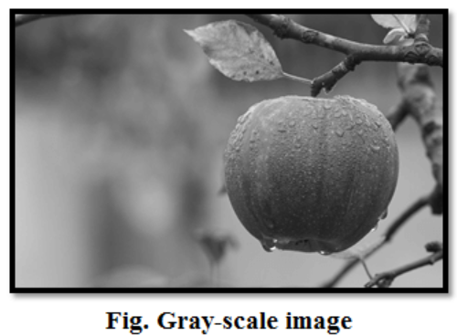
Types of Images
Gray-scale images

Slide 11
Types of Images
Color images
Colour images are three band monochrome images in which, each band contains a different color and the actual information is stored in the digital image.
The color images contain grey level information in each spectral band.
The images are represented as red, green and blue (RGB images). Each color image has 24 bits/pixel means 8 bits for each of the three color band(RGB).

Slide 12
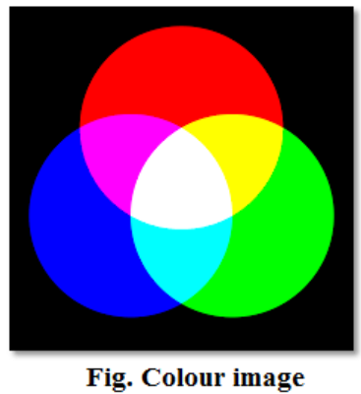
Types of Images
Color images

Slide 13
Types of Images
Color images
8-bit color format
8-bit color is used for storing image information in a computer's memory or in a file of an image.
In this format, each pixel represents 8 bits.
It has 0-255 range of colors, in which 0 is used for black, 255 for white and 127 for gray color.
The 8-bit color format is also known as a grayscale image. Initially, it was used by the UNIX operating system.

Slide 14
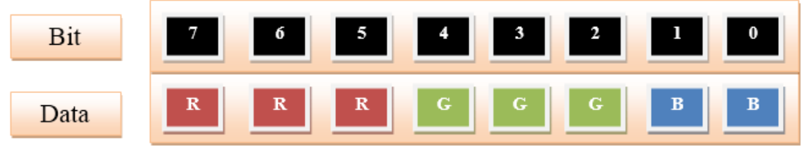
Types of Images
Color images
8-bit color format

Slide 15
Types of Images
Color images
16-bit color format
The 16-bit color format is also known as high color format.
It has 65,536 different color shades. It is used in the system developed by Microsoft.
The 16-bit color format is further divided into three formats which are Red, Green, and Blue also known as RGB format.
In RGB format, there are 5 bits for R, 6 bits for G, and 5 bits for B. One additional bit is added in green because in all the 3 colors green color is soothing to eyes.

Slide 16
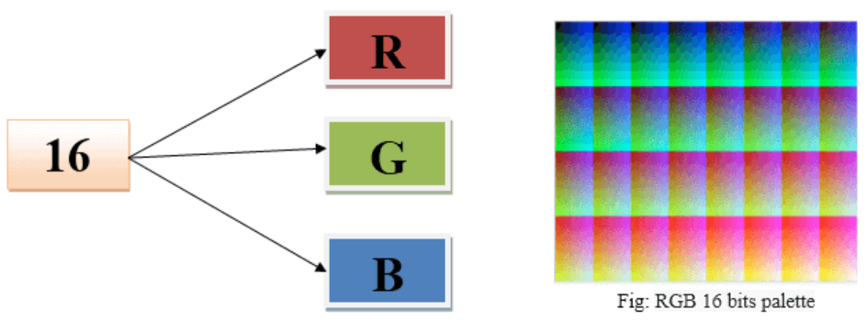
Types of Images
Color images
16-bit color format

Slide 17
Types of Images
Color images
24-bit color format
The 24-bit color format is also known as the true color format.
The 24-bit color format is also distributed in Red, Green, and Blue.
As 24 can be equally divided on 8, so it is distributed equally between 3 different colors like 8 bits for R, 8 bits for G and 8 bits for B.

Slide 18
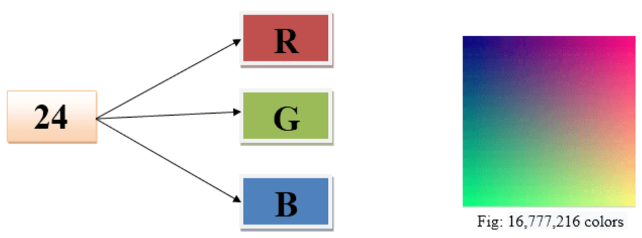
Types of Images
Color images
24-bit color format

Slide 19
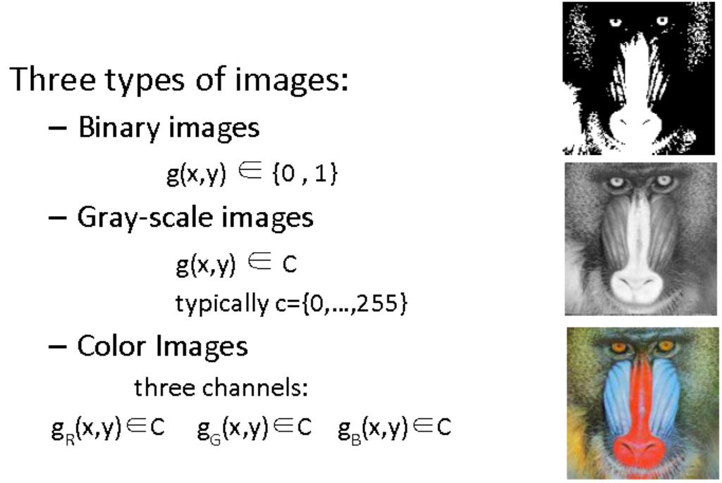
Types of Images

Slide 20
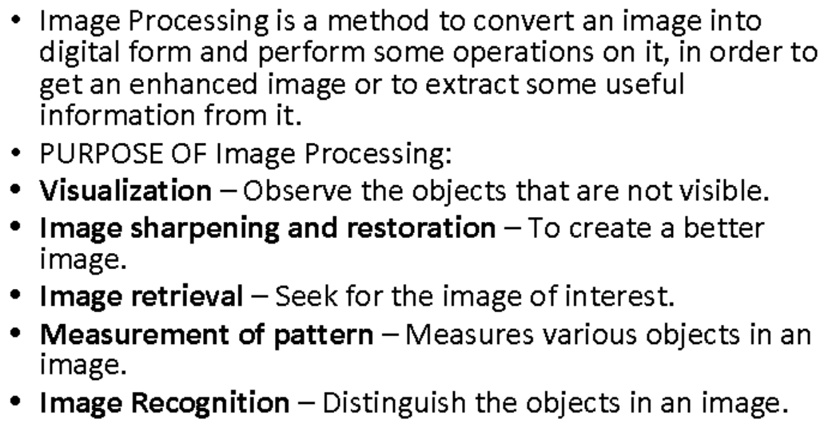
Image Processing - Basics

Slide 21
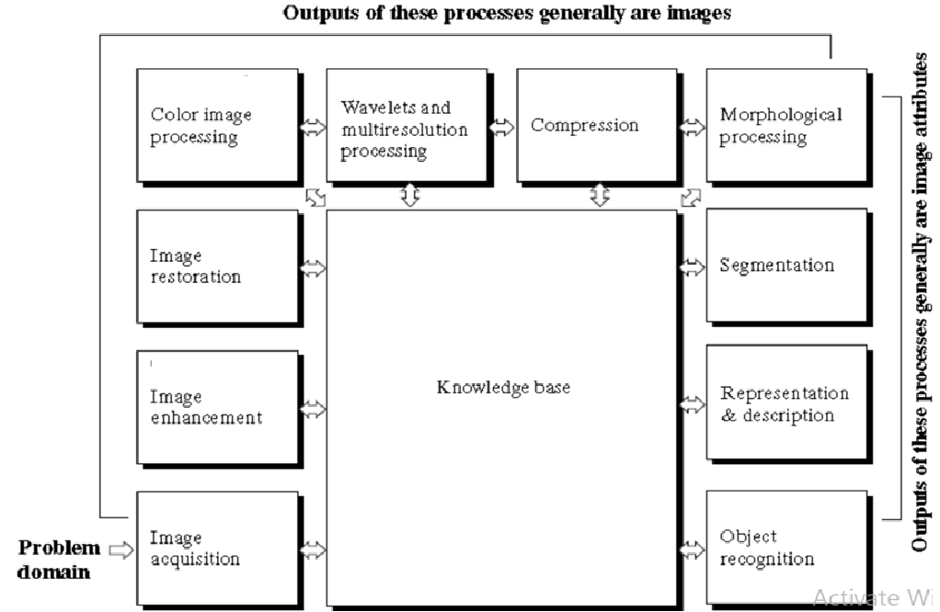
Image Processing - Basics
Fundamental Steps in Image Processing

Slide 22
Image Processing - Basics
1.ACQUISITION– It could be as simple as being given an image which is in digital form. The main work involves: a) Scaling b) Color conversion(RGB to Gray or vice-versa)
2.IMAGE ENHANCEMENT– It is amongst the simplest and most appealing in areas of Image Processing it is also used to extract some hidden details from an image and is subjective.
3.IMAGE RESTORATION– It also deals with appealing of an image but it is objective(Restoration is based on mathematical or probabilistic model or image degradation).

Slide 23
Image Processing - Basics
4.COLOR IMAGE PROCESSING– It deals with pseudocolor and full color image processing color models are applicable to digital image processing.
5.WAVELETS AND MULTI-RESOLUTION PROCESSING– It is foundation of representing images in various degrees.
6.IMAGE COMPRESSION-It involves in developing some functions to perform this operation. It mainly deals with image size or resolution.
7.MORPHOLOGICAL PROCESSING-It deals with tools for extracting image components that are useful in the representation & description of shape.

Slide 24
Image Processing - Basics
8.SEGMENTATION PROCEDURE-It includes partitioning an image into its constituent parts or objects. Autonomous segmentation is the most difficult task in Image Processing.
9.REPRESENTATION & DESCRIPTION-It follows output of segmentation stage, choosing a representation is only the part of solution for transforming raw data into processed data.
10.OBJECT DETECTION AND RECOGNITION-It is a process that assigns a label to an object based on its descriptor

Slide 25
Image Processing - Basics
Benefits of Image Processing
The digital image can be made available in any desired format (improved image, X-Ray, photo negative, etc)
It helps to improve images for human interpretation
Information can be processed and extracted from images for machine interpretation
The pixels in the image can be manipulated to any desired density and contrast
Images can be stored and retrieved easily
It allows for easy electronic transmission of images to third-party providers

Slide 26
Point Operations
Sometimes, pictures taken from the camera may provide poor quality.
They were the result of the lighting conditions at that moment. So, we need to use image processing techniques to enhance image quality
Some of the image processing techniques are
Point Operation
Auto-contrast Adjustment
Modified Auto-Contrast
Histogram Equalization
Histogram Specification
Etc..

Slide 27
Point Operations
Point Operation is the modification of the pixel value without changing in the size, geometry and local structure of the image.
The new pixel value depends only on the previous value.
They are mapped by a function f(a), if the function f() not depend on the coordinate, it is called “global” or “homogeneous” operation.
Another one is called “non-homogeneous” point operation, if it depends on the coordinate.
Non-homogeneous point operation is used to compensate for uneven lighting during image acquisition.

Slide 28
Point Operations
The common examples of homogeneous operation include:
Modifying contrast and brightness
Limiting the Result by Clamping
Inverting Image
Threshold Operation

Slide 29
Point Operations
Here, each pixel value is replaced with a new value obtained from the old one.
If we want to increase the brightness to stretch the contrast, we can simply multiply all pixel values by a scalar, say by 2, to double the range.
Conversely, to reduce the contrast, we can divide all point values by a scalar.
If the overall brightness is controlled by a level, l, (e.g., the brightness of global light) and the range is controlled by a gain, k, the brightness of the points in a new picture, N, can be related to the brightness in old picture, O, by

Slide 30
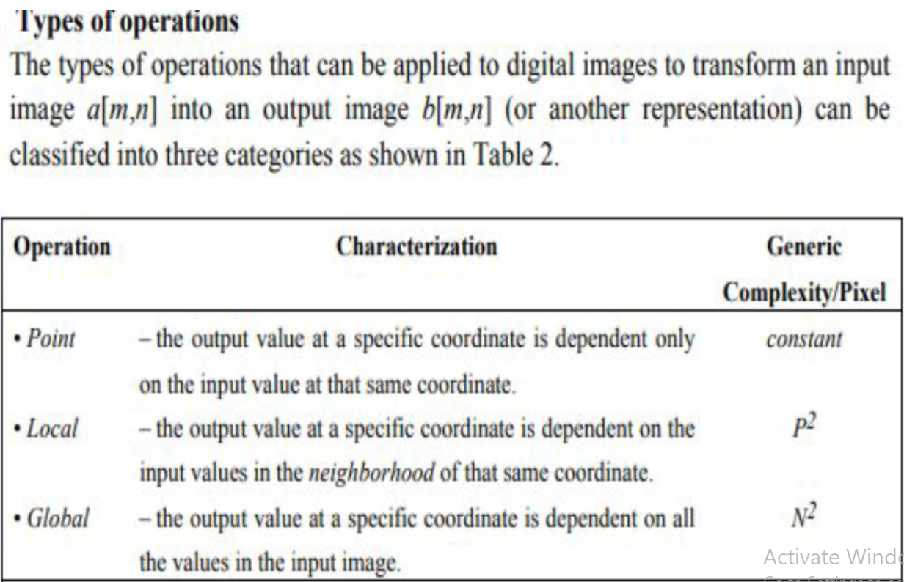
Point Operations

Slide 31
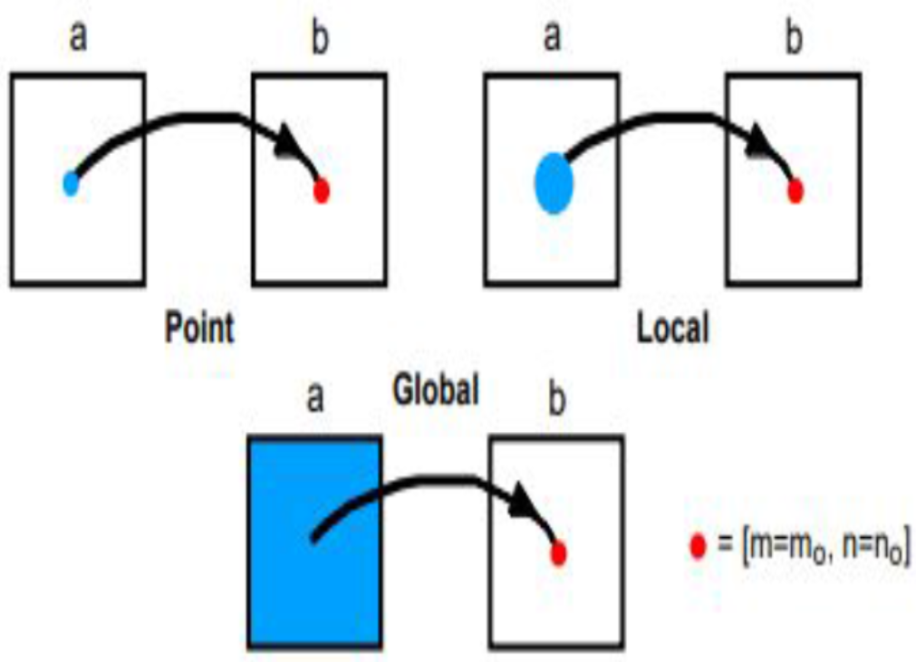
Point Operations
Point Operation can be defined as follows:
g(x, y) = T(f(x, y)) where
g (x, y) is the output image
T is an operator of intensity transformation
f (x, y) is the input image

Slide 32
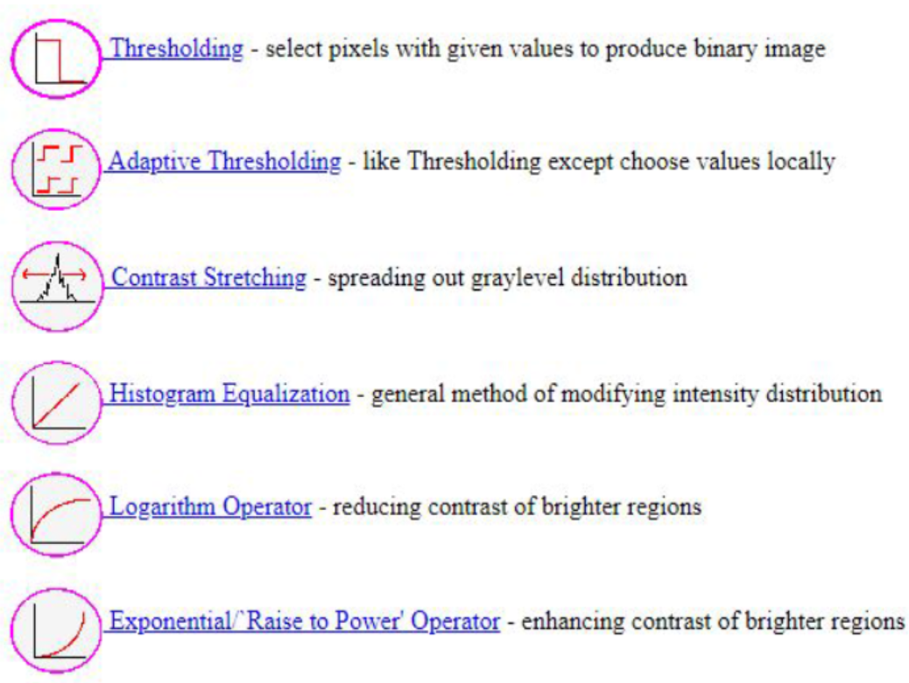
Different Types of Point Operations

Slide 33
Thresholding
In many vision applications, it is useful to separate out the regions of the image corresponding to objects in which we are interested, from the background.
Thresholding provides an easy way to perform this segmentation on the basis of the different intensities or colors in the foreground and background regions of an image.
It is useful to see what areas of an image consist of pixels whose values lie within a specified range, or band of intensities (or colors).

Slide 34
Point Operation - Thresholding
It selects pixels that have a particular value or are within a specified range.
It can be used to find objects within a picture if their brightness level (or range) is known.
This implies that the object’s brightness must be known as well.
There are two main forms: uniform and adaptive thresholding

Slide 35
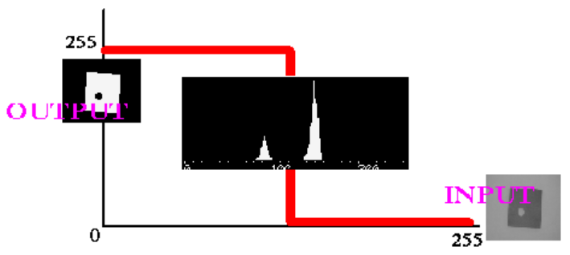
Point Operation - Thresholding

Slide 36
Point Operation - Thresholding
In uniform thresholding, pixels above a specified level are set to white, those below the specified level are set to black
It provides a way of isolating points of interest.
It requires knowledge of the gray level, or the target features might not be selected in the thresholding process.
If the level is not known, histogram equalization or intensity normalization can be used

Slide 37
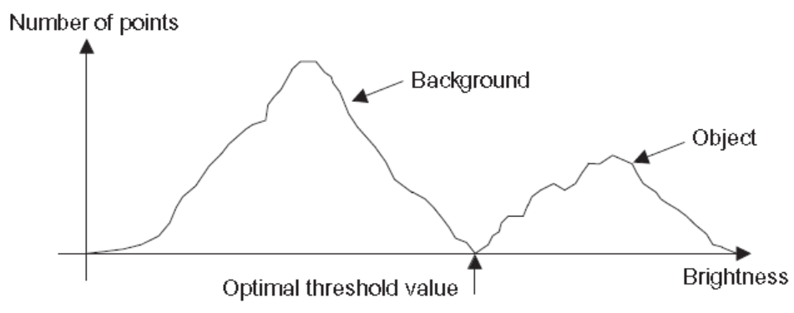
Point Operation - Thresholding
Optimal or Adaptive Thresholding
It seeks to select a value for the threshold that separates an object from its background.
This suggests that the object has a different range of intensities to the background, in order that an appropriate threshold can be chosen

Slide 38
Interpolation
Image interpolation occurs in all digital photos at some stage
It happens anytime you resize or remap (distort) your image from one pixel grid to another.
Image resizing is necessary when you need to increase or decrease the total number of pixels
whereas remapping can occur under a wider variety of scenarios: correcting for lens distortion, changing perspective, and rotating an image.

Slide 39

Interpolation
Even if the same image resize or remap is performed, the results can vary significantly depending on the interpolation algorithm.
It is only an approximation, therefore an image will always lose some quality each time interpolation is performed.

Slide 40
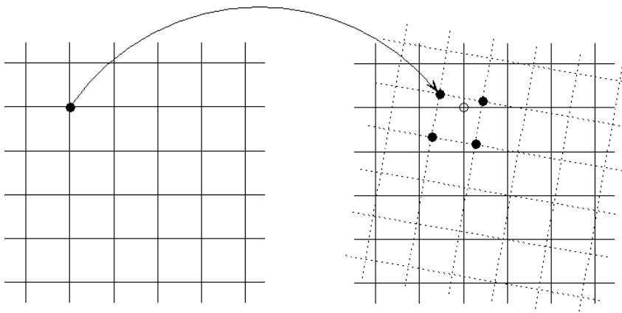
Interpolation
Interpolation is needed to find the value of the image at the grid points in the target coordinate system.
The mapping T locates the grid points of A in the coordinate system of B, but those grid points are not on the grid of B.

Slide 41
Interpolation
To find the values on the grid points of B we need to interpolate from the values at the projected locations.
Finding the closest projected points to a given grid point can be computationally expensive.
Projecting the grid of B into the coordinate system of A maintains the known image values on a regular grid. This makes it simple to find the nearest points for each interpolation calculation

Slide 42
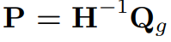
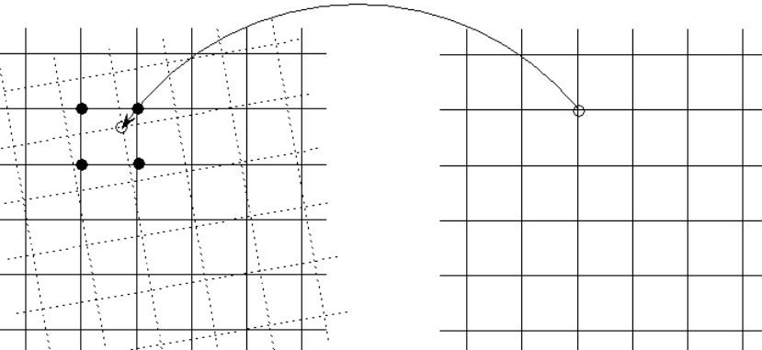
Interpolation
Let Qg be the homogeneous grid coordinates of B and let H be the transformation from A to B. Then
represents the projection from B to A.
We want to find the value at each point P given from the values on Pg, the homogeneous grid coordinates of A.

Slide 43
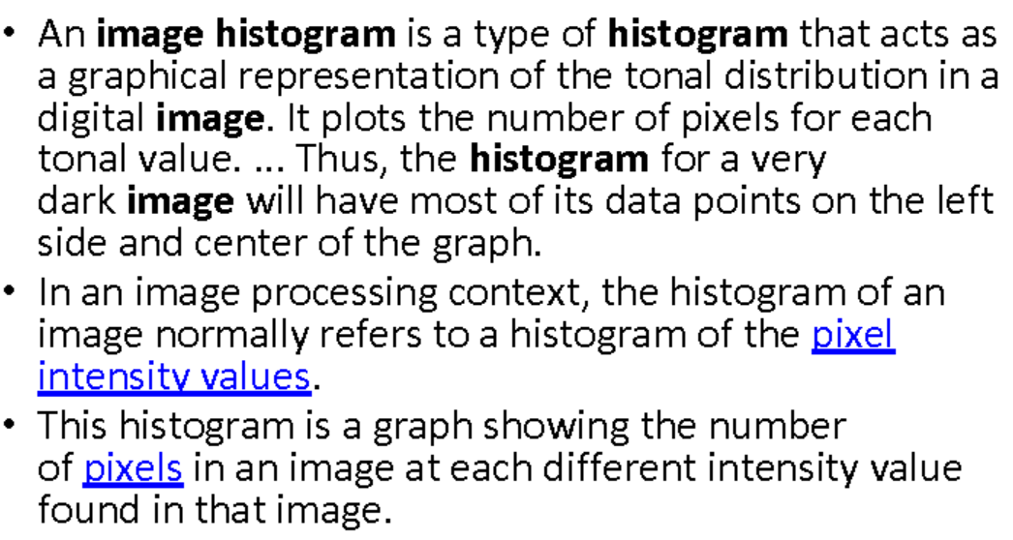
Histogram

Slide 44
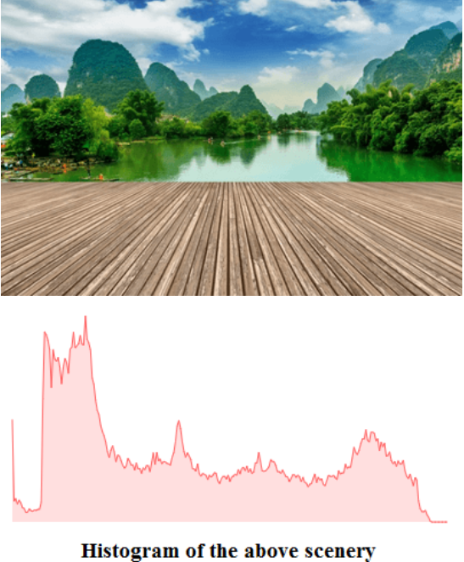
Histogram

Slide 45
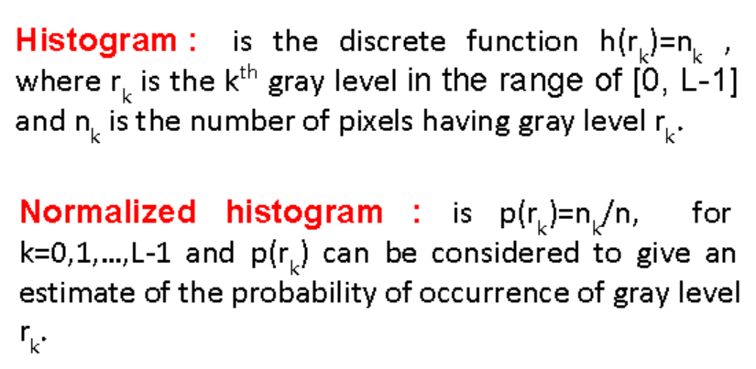
Histogram

Slide 46
Histogram Equalization
Histogram equalization is used for equalizing all the pixel values of an image.
Transformation is done in such a way that uniform flattened histogram is produced.
Histogram equalization increases the dynamic range of pixel values and makes an equal count of pixels at each level which produces a flat histogram with high contrast image.

Slide 47
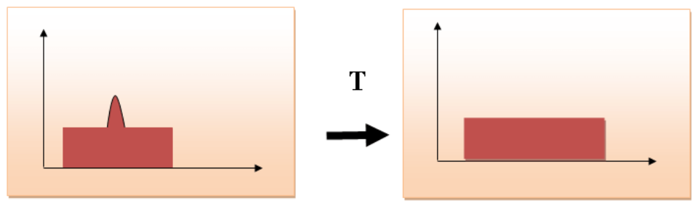
Histogram Equalization

Slide 48
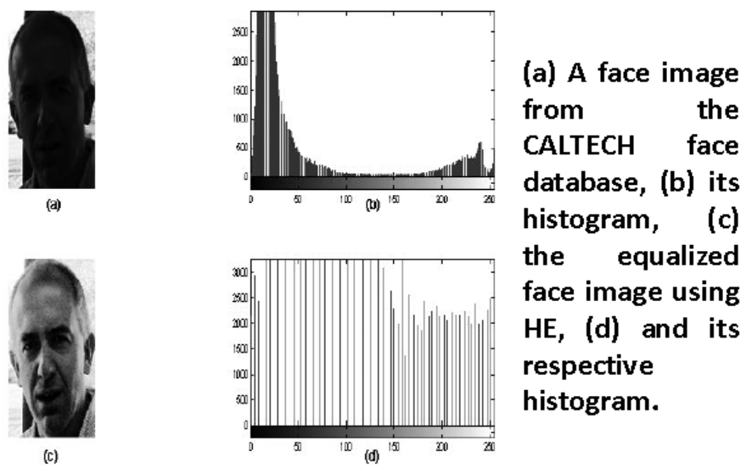
Histogram Equalization

Slide 49
Applications of Histogram
In digital image processing, histograms are used for simple calculations in software.
It is used to analyze an image. Properties of an image can be predicted by the detailed study of the histogram.
The brightness of the image can be adjusted by having the details of its histogram.
The contrast of the image can be adjusted according to the need by having details of the x-axis of a histogram.
It is used for image equalization. Gray level intensities are expanded along the x-axis to produce a high contrast image.
Histograms are used in thresholding as it improves the appearance of the image

Slide 50
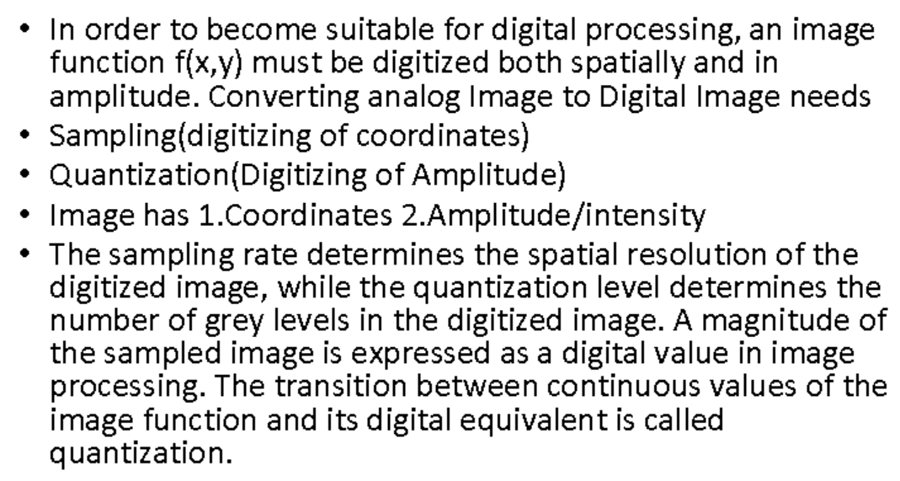
Sampling & Quantization

Slide 51
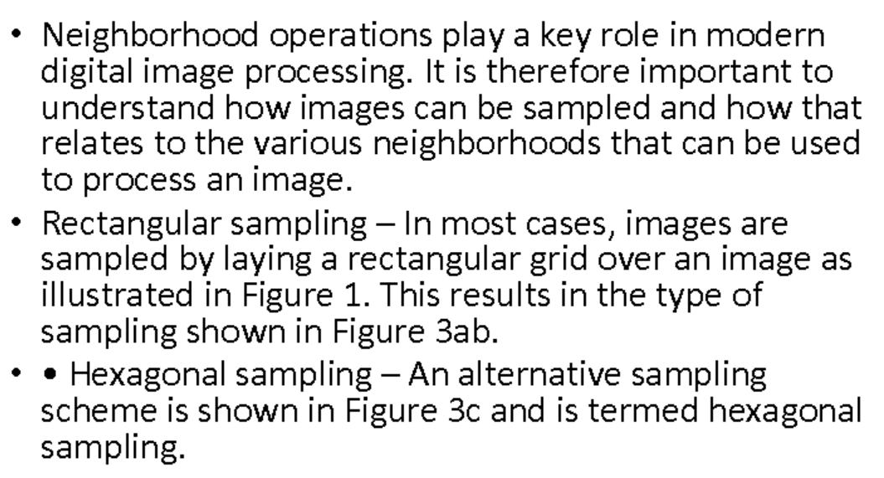
Types of Neighbourhood

Slide 52
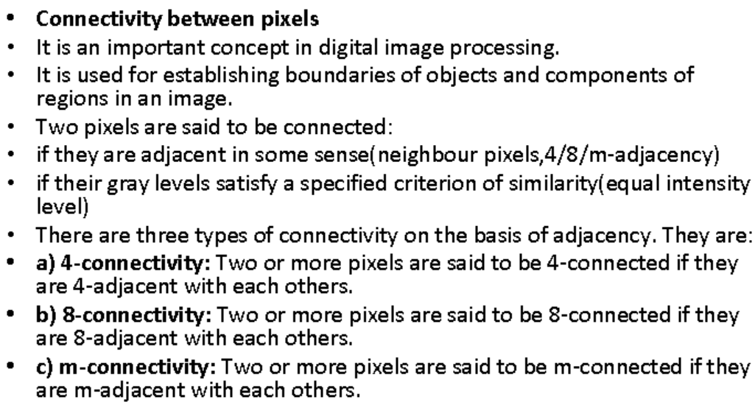
Types of Neighbourhood

Slide 53
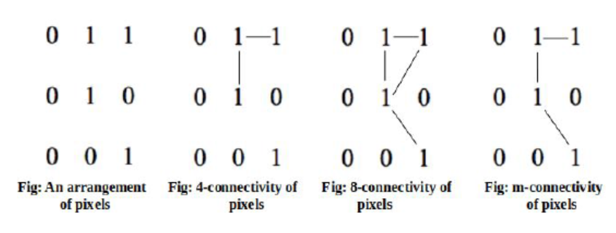
Types of Neighbourhood

Slide 54
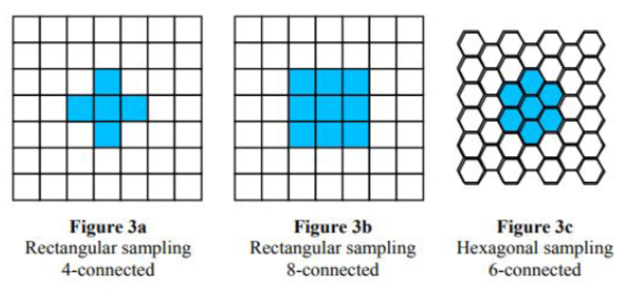
Sampling Techniques

Slide 55
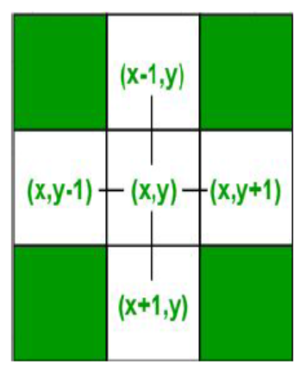
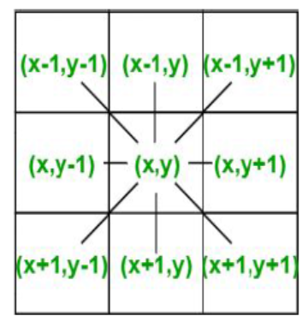
4 – Connected Vs 8 - Connected

Slide 56
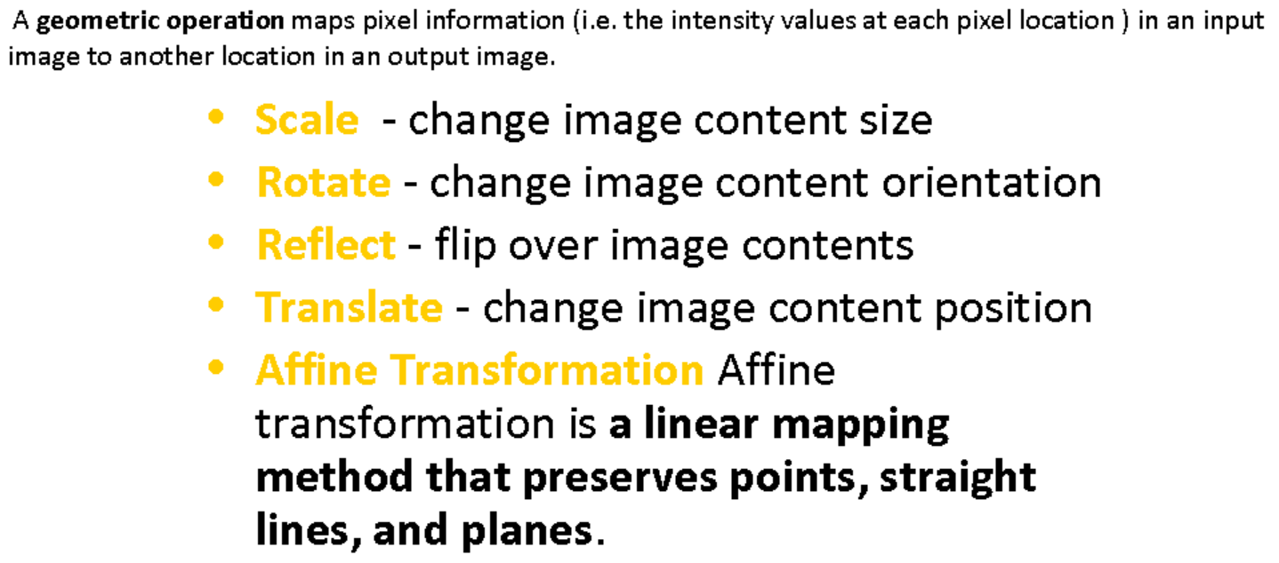
Geometric Transformations

Slide 57
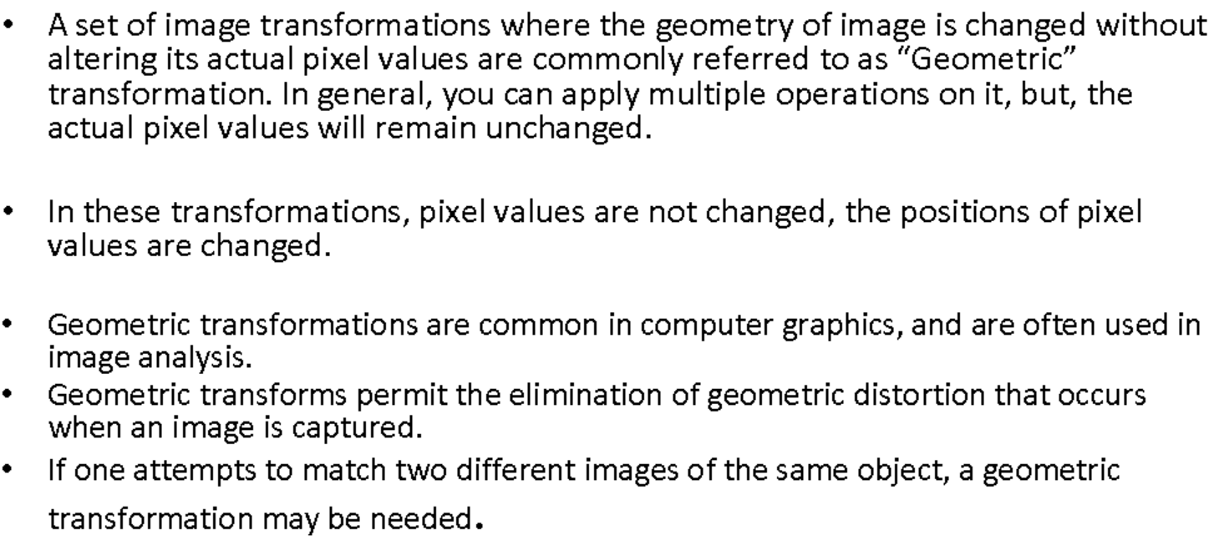
Geometric Transformations

Slide 58
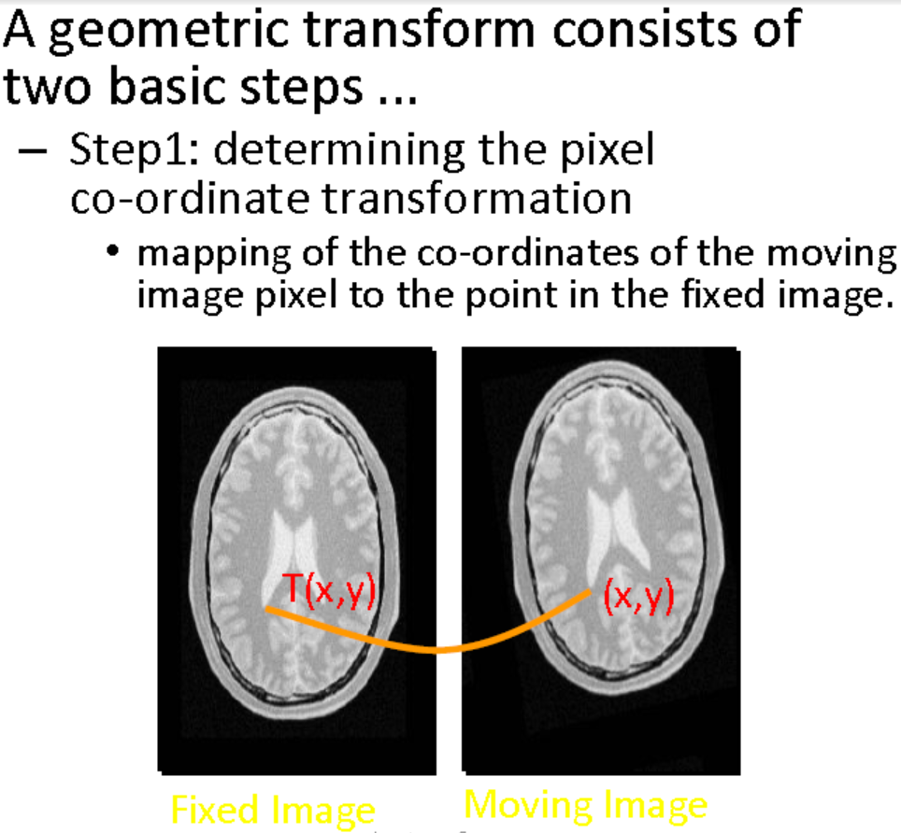
Geometric Transformations

Slide 59
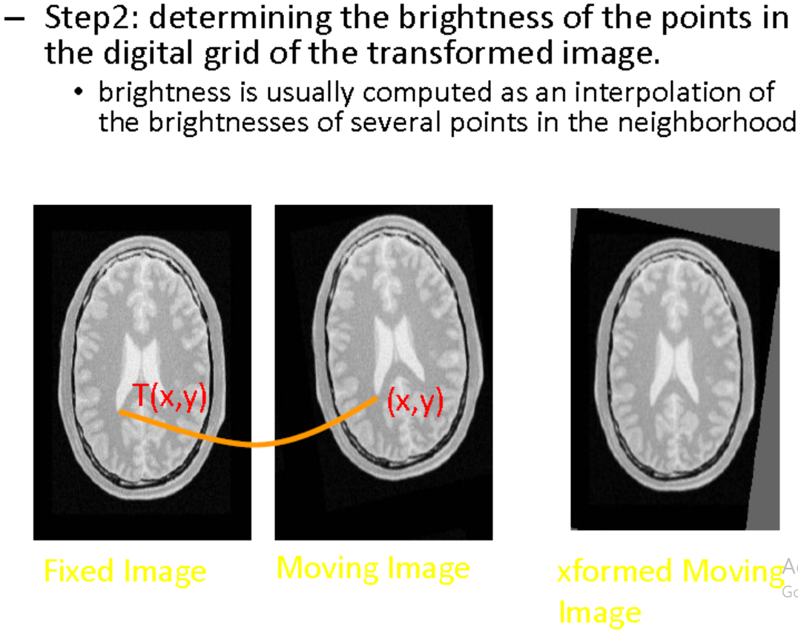
Geometric Transformations

Slide 60
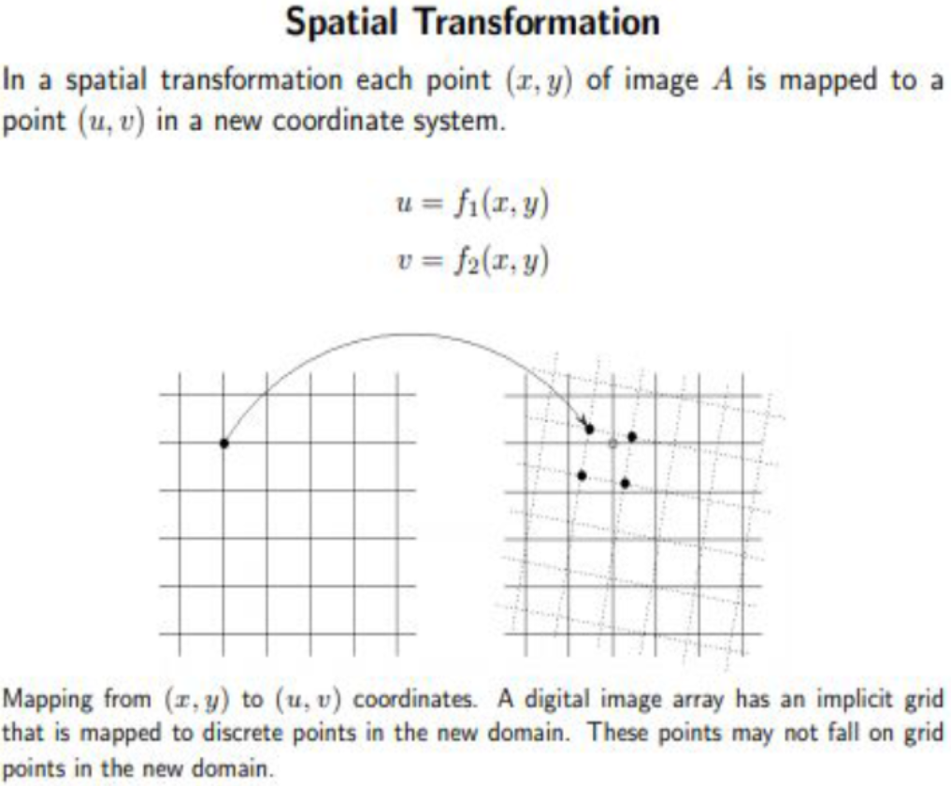
Geometric Transformations

Slide 61
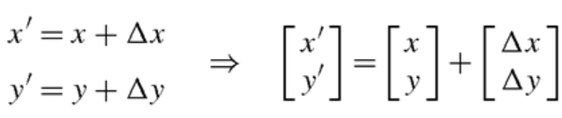
Major Geometric Transformations
Translation
Let us now look at the transformations in Fig. and define their concrete mapping equations. Translation is simply a matter of shifting the image horizontally and vertically with a given off-set (measured in pixels) denoted Ax and Ay. For translation the mapping is thus defined as
So if Ax = 100 and Ay = 100 then each pixel is shifted 100 pixels in both the x- and y-direction

Slide 62
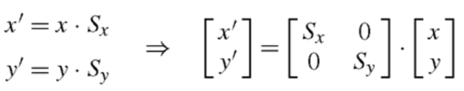
Major Geometric Transformations
Scaling
When scaling an image, it is made smaller or bigger in the x- and/or y-direction.
Say we have an image of size 300 x 200 and we wish to transform it into a 600 x 100 image. The x-direction is then scaled by: 600/300 = 2.
We denote this the x-scale factor and write it as Sx = 2. Similarly Sy = 100/200 = 1/2. Together this means that the pixel in the image f(x, y) at position (x, y) = (100,100) is mapped to anew position in the image g(x’,y’), namely (x ‘ ,y’) = (100 · 2,100 · 1/2) = (200, 50).
In general, scaling is expressed as

Slide 63
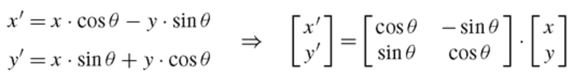
Major Geometric Transformations
Rotation
When rotating an image, as illustrated in Fig. we need to define the amount of rotation in terms of an angle.
We denote this angle θ meaning that each pixel in f(x, y) is rotated θ degrees.
The transformation is defined as

Slide 64
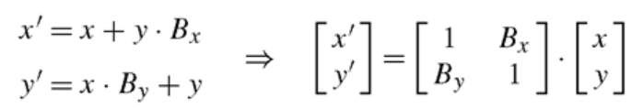
Major Geometric Transformations
Shearing
To shear an image means to shift pixels either horizontally, Bx, or vertically, By.
The difference from translation is that the shifting is not done by the same amount, but depends on wherein the image a pixel is.
The transformation is defined as

Slide 65
Edge Detection
Edges: are abrupt changes in intensity, discontinuity in image brightness or contrast; usually edges occur on the boundary of two regions.
Edge detection: is an image processing technique for finding the boundaries of objects within images.
It works by detecting discontinuities in brightness.
Edge detection is used for image segmentation and data extraction in areas such as image processing, computer vision, and machine vision.

Slide 66
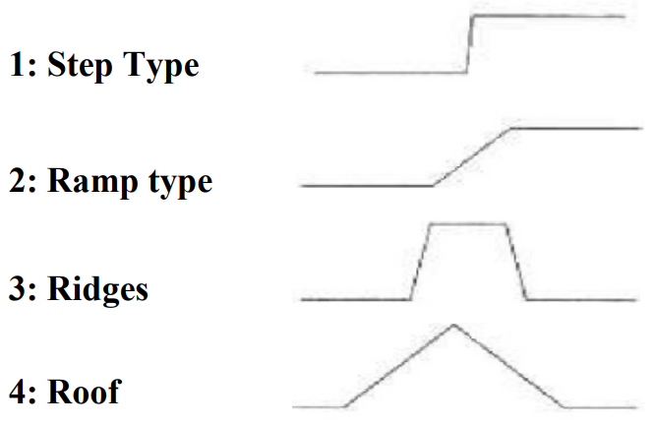
Edge Detection
Why we use edge detection?
Reduce unnecessary information in the image while preserving the structure of the image.
Extract important features of an image such as corners, lines, and curves.
Edges provide strong visual clues that can help the recognition process.
Type of edges

Slide 67
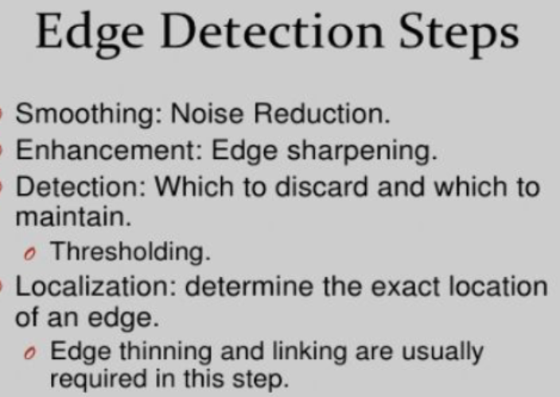
Edge Detection

Slide 68
Edge Detection Methods
There are various methods, and the following are some of the most commonly used methods-
Roberts edge detection
Prewitt edge detection
Sobel edge detection
Laplacian edge detection
Canny edge detection

Slide 69
First Order & Second Order Derivatives
This method we take the 1 st derivative of the intensity value across the image and find points where the derivative is maximum then the edge could be located.
The gradient is a vector, whose components measure how rapid pixel value are changing with distance in the x and y direction.
Magnitude of Gradient vector is used for implementation of first order derivative in image processing
Laplacian is for second order implementation in image processing.

Slide 70
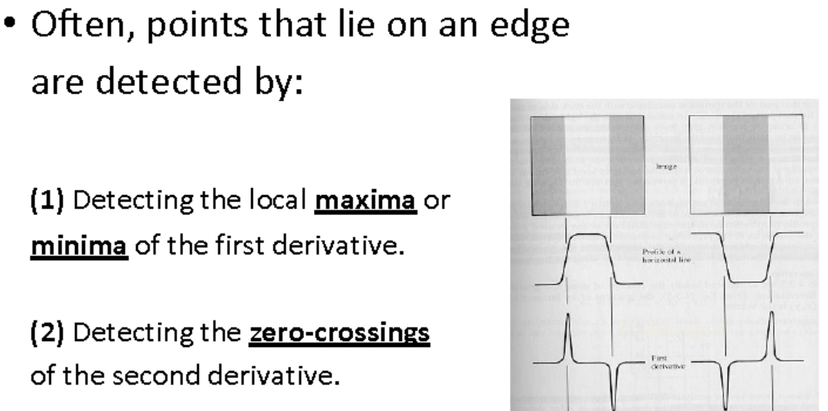
Edge Detection using Derivatives

Slide 71
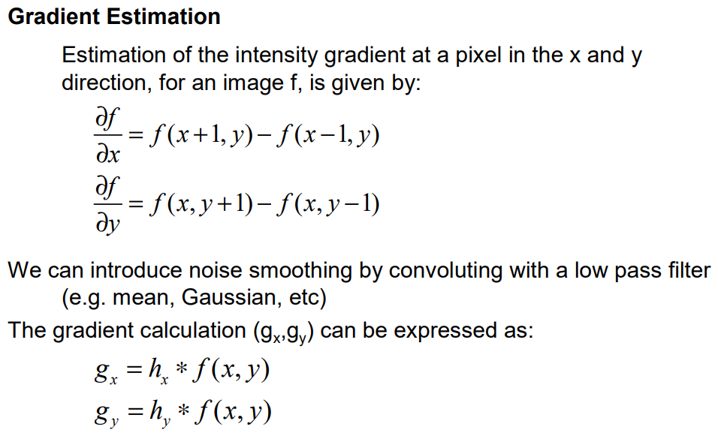
1st & 2nd Order Derivatives

Slide 72
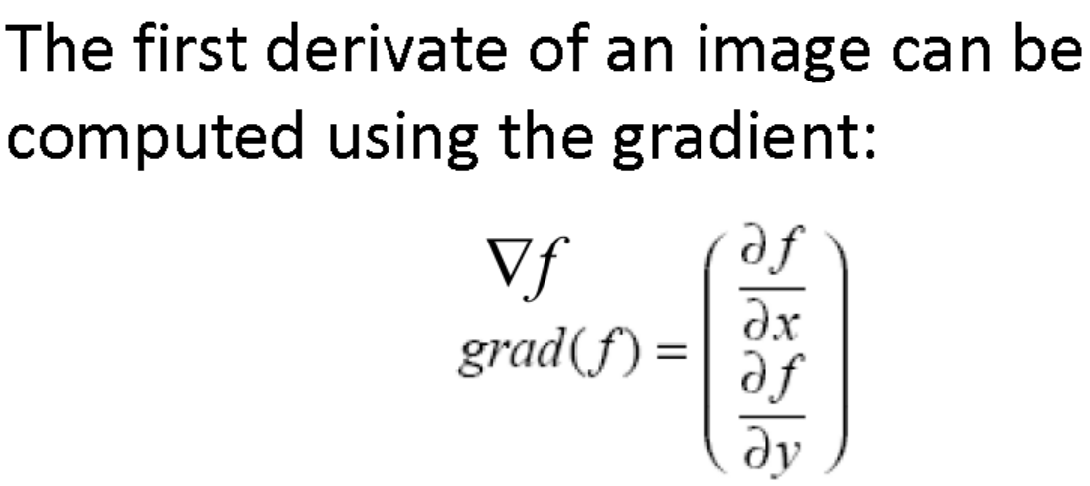
Edge Detection Using First Derivative (Gradient)
The gradient is a vector which has magnitude and
direction:

Slide 73
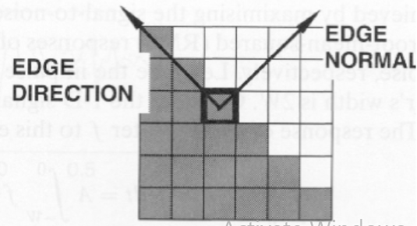
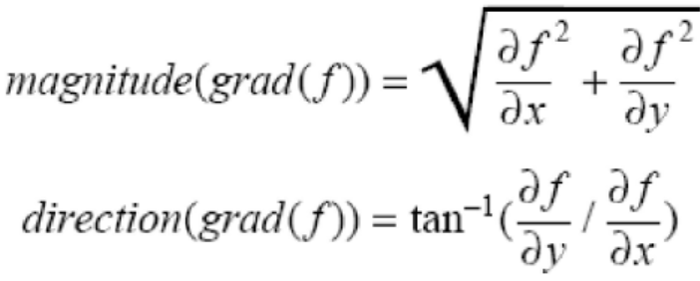
Edge Detection Using First Derivative (Gradient)
Magnitude: indicates edge strength.
Direction: indicates edge direction.
– i.e., perpendicular to edge direction

Slide 74
Session 7
• Robert's method,
• Sobel's method,
• Perwitts

Slide 75
Roberts Edge Detection
The Roberts Cross operator performs a simple, quick to compute, 2-D spatial gradient measurement on an image.
It highlights regions of high spatial frequency which often correspond to edges.
The input to the operator is a grayscale image, as is the output.
Pixel values at each point in the output represent the estimated absolute magnitude of the spatial gradient of the input image at that point

Slide 76
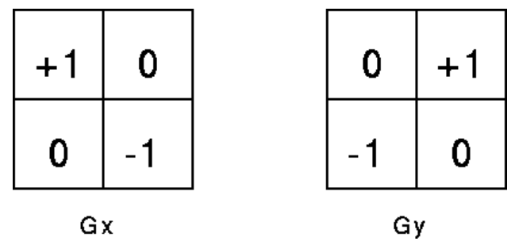
Roberts Edge Detection
Robert Operator: It is a gradient-based operator computes the sum of squares of the differences between diagonally adjacent pixels in an image through discrete differentiation.
Then the gradient approximation is made. It uses the following 2 x 2 kernels or masks –

Slide 77
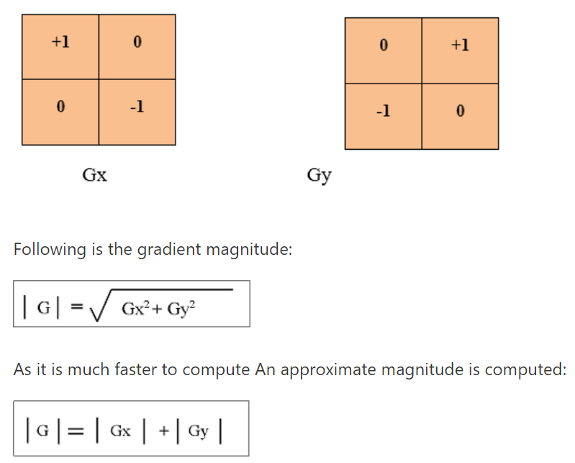
The Roberts cross operator

Slide 78
Roberts Edge Detection
1: Input – Read an image
2: Convert the true-color RGB image to the grayscale image
3: Convert the image to double4: Pre-allocate the filtered_image matrix with zeros
5: Define Robert Operator Mask
6: Edge Detection Process (Compute Gradient approximation and magnitude of vector)
7: Display the filtered image
8: Thresholding on the filtered image
9: Display the edge-detected image

Slide 79
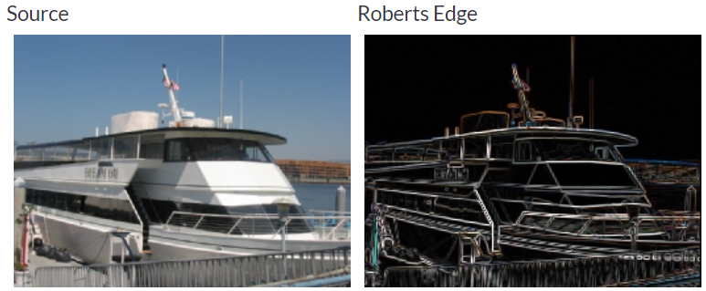
Roberts Edge Detection

Slide 80
Roberts Edge Detection
Advantages:
Detection of edges and orientation are very easy
Diagonal direction points are preserved
Limitations:
Very sensitive to noise
Not very accurate in edge detection

Slide 81
Sobel Edge Detection Method
The Sobel operator performs a 2-D spatial gradient measurement on an image and so emphasizes regions of high spatial frequency that correspond to edges.
It is used to find the approximate absolute gradient magnitude at each point in an input grayscale image.
The operator consists of a pair of 3×3 convolution kernels. One kernel is simply the other rotated by 90°.
This is very similar to the Roberts Cross operator.

Slide 82
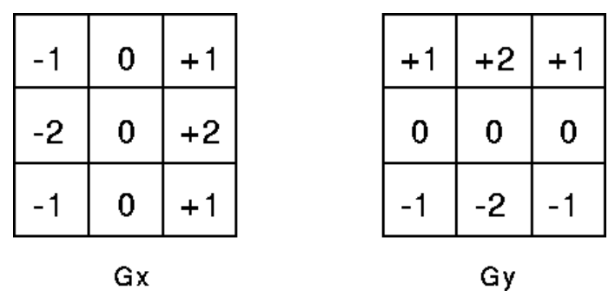
Sobel Edge Detection Method
The Sobel Operator

Slide 83

Sobel Edge Detection Method

Slide 84

Sobel Edge Detection Method

Slide 85
Sobel Edge Detection Method
It works by calculating the gradient of image intensity at each pixel within the image.
It finds the direction of the largest increase from light to dark and the rate of change in that direction.
The result shows how abruptly or smoothly the image changes at each pixel, and therefore how likely it is that that pixel represents an edge. It also shows how that edge is likely to be oriented.
The result of applying the filter to a pixel in a region of constant intensity is a zero vector.
The result of applying it to a pixel on an edge is a vector that points across the edge from darker to brighter values.

Slide 86

Sobel Edge Detection Method

Slide 87


The Prewitt operator
Prewitt operator is a differentiation operator.
Prewitt operator is used for calculating the approximate gradient of the image intensity function.
In an image, at each point, the Prewitt operator results in gradient vector or normal vector.
In Prewitt operator, an image is convolved in the horizontal and vertical direction with small, separable and integer-valued filter. It is inexpensive in terms of computations.

Slide 88

Templates of Prewitt operator

Slide 89

Summary

Slide 90
Second Order Derivatives
• Laplacian of Gaussian,
• Zero crossing

Slide 91
Laplacian of Gaussian
The Laplacian is a 2-D isotropic measure of the 2nd spatial derivative of an image.
The Laplacian of an image highlights regions of rapid intensity change and is often used for edge detection.
The Laplacian is often applied to an image that has first been smoothed with something approximating a Gaussian smoothing filter in order to reduce its sensitivity to noise, and hence the two variants will be described together here
The operator normally takes a single graylevel image as input and produces another graylevel image as output.

Slide 92


Second Order Derivatives
A very popular second order operator is the Laplacian operator.
The Laplacian of a function f(x,y), is defined by:
The Template for LT is
In Laplacian, the input image is represented as a set of discrete pixels. So, discrete convolution kernel which can approximate second derivatives in the definition is found.

Slide 93

Second Order Derivatives

Slide 94

Templates for LT Operator
There are disadvantages to the use of second order derivatives.
Second derivatives will exaggerated noise twice as much.
No directional information about the edge is given.
The problems that the presence of noise causes when using edge detectors means we should try to reduce the noise in an image prior to or in conjunction with the edge detection process.

Slide 95

Gaussian
Another smoothing method is Gaussian smoothing
Gaussian smoothing is performed by convolving an image with a Gaussian operator which is defined below.
By using Gaussian smoothing in conjunction with the Laplacian operator, or another Gaussian operator, it is possible to detect edges.
Lets look at the Gaussian smoothing process first.
The Gaussian distribution function in two variables, g(x,y), is defined by
where sigma is the standard deviation representing the width of the Gaussian distribution

Slide 96


Gaussian

Slide 97

LOG

Slide 98

The LOG operator
This method of edge detection was first proposed by Marr and Hildreth at MIT who introduced the principle of the zero-crossing method.
The basic principle of this method is to find the position in an image where the second derivatives become zero.
These positions correspond to edge positions as shown in

Slide 99

LOG

Slide 100

Zero Crossing

Slide 101

The LOG operator
Zero Crossing based Edge Detection
The Gaussian function firstly smooths or blurs any step edges.
The second derivative of the blurred image is taken; it has a zero-crossing at the edge.
NOTE: Blurring is advantageous here: - Laplacian would be infinity at (unsmoothed) step edge.
- Edge position still preserved

Slide 102

The LOG based Edge Detection

Slide 103

The LOG based Edge Detection
LOG operator is still susceptible to noise, but the effects of noise can be reduced by ignoring zero-crossings produced by small changes in image intensity.
LOG operator gives edge direction information as well as edge points - determined from the direction of the zero-crossing

Slide 104

The LOG based Edge Detection

Slide 105
Session 8 and 9
Low Level Features Extraction
Describing Image Motion
High Level Features Extraction
Template Matching
Hough Transform for Lines
Hough Transforms for Circles and Elipses

Slide 106

Low Level Feature Extraction

Slide 107

Low Level Feature Extraction

Slide 108

Low Level Feature Extraction
Difference Image

Slide 109
Approaches to Detect Motions
There are many approaches for detecting the motion in an image
Area Based Approach
Differential Approach

Slide 110

Area Based Approach

Slide 111

Area Based Approach

Slide 112

Area Based Approach

Slide 113

Differential Approach

Slide 114

Differential Approach

Slide 115

Differential Approach

Slide 116

Difference between AB and DB Approaches

Slide 117

Difference between AB and DB Approaches

Slide 118

High Level Features

Slide 119

Template Matching

Slide 120

Template Matching

Slide 121

Template Matching

Slide 122
Hough Transform
The Hough transform is a technique which can be used to isolate features of a particular shape within an image.
Because it requires that the desired features be specified in some parametric form, the classical Hough transform is most commonly used for the detection of regular curves such as lines, circles, ellipses, etc.
The idea behind the Hough technique for line detection is that each input measurement (e.g. coordinate point) indicates its contribution to a globally consistent solution (e.g. the physical line which gave rise to that image point).

Slide 123

Hough Transform
As an example, consider the common problem of fitting a set of line segments to a set of discrete image points (e.g. pixel locations output from an edge detector).
Figure shows some possible solutions to this problem.
Here the lack of a priori knowledge about the number of desired line segments render this problem under-constrained.

Slide 124
Hough Transform
The Hough Space is a 2D plane that has a horizontal axis representing the slope and the vertical axis representing the intercept of a line on the edge image.
A line on an edge image is represented in the form of y = ax + b
One line on the edge image produces a point on the Hough Space since a line is characterized by its slope a and intercept b.
On the other hand, an edge point (xᵢ, yᵢ) on the edge image can have an infinite number of lines pass through it.
Therefore, an edge point produces a line in the Hough Space in the form of b = axᵢ + yᵢ

Slide 125
Hough Transform
In the Hough Transform algorithm, the Hough Space is used to determine whether a line exists in the edge image.
There is one flaw with representing lines in the form of y = ax + b and the Hough Space with the slope and intercept.
In this form, the algorithm won’t be able to detect vertical lines because the slope a is undefined/ infinity for vertical lines

Slide 126
Hough Transform
This means that a computer would need an infinite amount of memory to represent all possible values of a.
To avoid this issue, a straight line is instead represented by a line called the normal line that passes through the origin and perpendicular to that straight line.
The form of the normal line is ρ = x cos(θ) + y sin(θ) where ρ is the length of the normal line and θ is the angle between the normal line and the x axis.

Slide 127
Hough Transform
So, a convenient equation for describing a set of lines uses parametric or normal notion: ρ = x cos(θ) + y sin(θ)
where ρ is the length of a normal from the origin to this line and theta (θ) is the orientation of ρ with respect to the X-axis.
For any point (x,y ) on this line, ρ and θ are constant.
Instead of representing the Hough Space with the slope a and intercept b, it is now represented with ‘ρ’ and ‘θ’ where the horizontal axis is for the θ values and the vertical axis are for the ρ values.
The mapping of edge points onto the Hough Space works in a similar manner except that an edge point (xᵢ, yᵢ) now generates a cosine curve in the Hough Space instead of a straight line

Slide 128

Hough Transform

Slide 129
Hough Transform
As mentioned, an edge point produces a cosine curve in the Hough Space.
From this, if we were to map all the edge points from an edge image onto the Hough Space, it will generate a lot of cosine curves.
If two edge points lay on the same line, their corresponding cosine curves will intersect each other on a specific (ρ, θ) pair.
Thus, the Hough Transform algorithm detects lines by finding the (ρ, θ) pairs that have a number of intersections larger than a certain threshold.

Slide 130
Hough Transform – Algorithm
Determine the range of ρ and θ. Typically, the range of θ is [0, 180] degrees and ρ is [-d, d], where d is the diagonal length of the edge. It is important to quantize the range of ρ and θ, which means there should only be a finite number of possible values.
Create a 2D array called the “accumulator” with the dimensions (num_rhos, num_thetas) to represent the Hough Space and set all its values to zero.
Perform edge detection on the original image (ED). You can do this with any ED technique you like.

Slide 131
Hough Transform – Algorithm
4. For every pixel on the edge image, check whether the pixel is an edge pixel. If it is an edge pixel, loop over all possible values of θ, compute the corresponding ρ, find the θ and ρ index in the accumulator, then increase the accumulator base on those index pairs.
5. Iterate over the accumulator’s values. If the value is larger than a certain threshold, get the ρ and θ index, get the value of ρ and θ from the index pair which can then be converted back to the form of y = ax + b.

Slide 132
Hough Transform – Algorithm
Advantages
The HT benefits from not requiring all pixels on a single line to be contiguous. As a result, it can be quite effective when identifying lines with small gaps due to noise or when objects are partially occluded.
Disadvantages • It can produce deceptive results when objects align by accident; • Rather than finite lines with definite ends, detected lines are infinite lines defined by their (m,c) values.

Slide 133

Circles Detection using HT

Slide 134

Circles

Slide 135

Circles

Slide 136

Circles

Slide 137

Ellipse Detection using HT

Slide 138

Ellipse Detection using HT

Slide 139

Ellipses Axes

Slide 140

HT for Ellipses

Slide 141

HT for Ellipses

Slide 142
End of UNIT 1 (Part 2)

